Slide 1



Forecasting of Water Discharge in Dam
~Sunaina Rustagi
08915003120
IT - 2

Slide 2


Table of Contents
01
02
03
About Dataset
About Organization
Problem Statement
04
ML Models
05
Model Used
06
Prediction
Dataset Analysis
National Hydroelectric Power Station
Knowing about Problem
ARIMA Model

Slide 3
01
About Organization

Slide 4
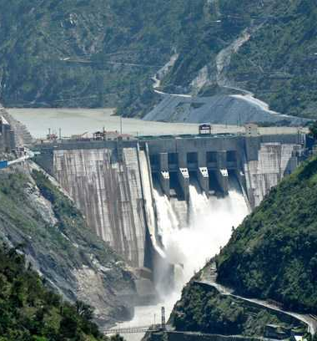

National Hydroelectric Power Corporation
NHPC Limited is an Indian government hydropower board under the ownership of Ministry of Power, Government of India that was incorporated in the year 1975
NHPC is operating 22 Power Stations with installed capacity of 5551.2 MW and annual design energy of 23612 MU. NHPC is a Mini Ratna Category-I Enterprise of the Govt. of India with an authorised share capital of ₹150,000 Million .

Slide 5
02
Problem Statement

Slide 6
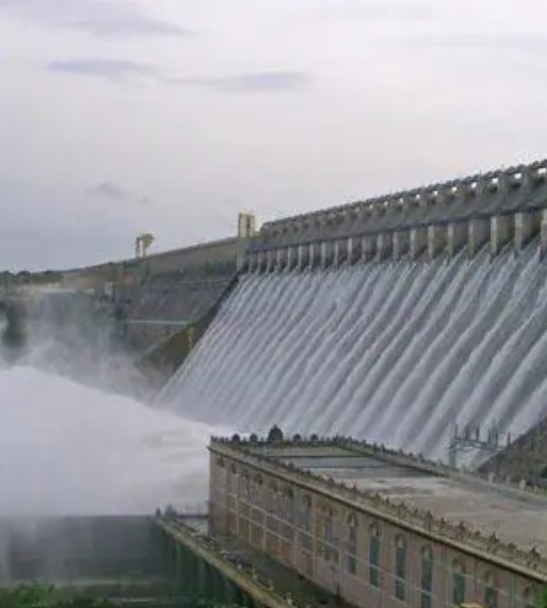
Problem
Water level monitoring at dams is a basic measurement. Water Level Sensors are deployed in the upstream region, 15-20 km away, to monitor the water level and safety of the upstream. The necessary data is regularly updated by these sensors. The water level (m) and discharge (m3/sec) are directly proportional, meaning that as the water level upstream rises, so will the discharge.

Slide 7
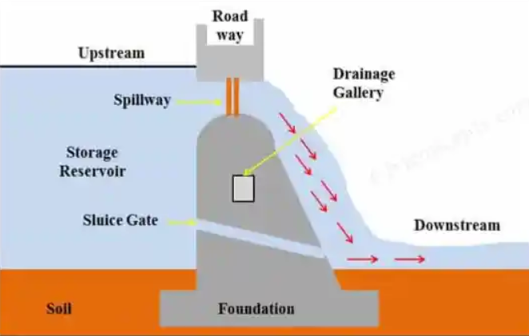

Slide 8
03
About Dataset

Slide 9
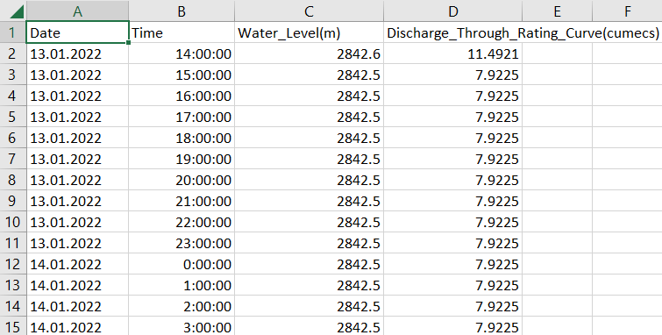
Dataset
Dataset consisted of 4 column as shown in the figure. The data for some hours is given for each day. The data varies for monsoon and non-monsoon season.

Slide 10


Dataset Preprocessing
Processing values of water level
Processing values of Water Discharge
Dropping null values
Recreating dataset
25 null values dropping
Avg of values taken for same values of date
Avg of values taken for same values of date
3 column dataset recreated

Slide 11
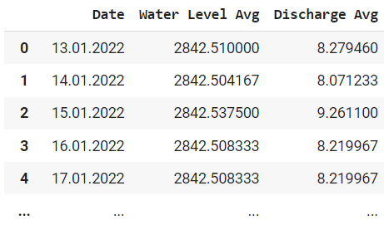

Slide 12
04
ML Models

Slide 13
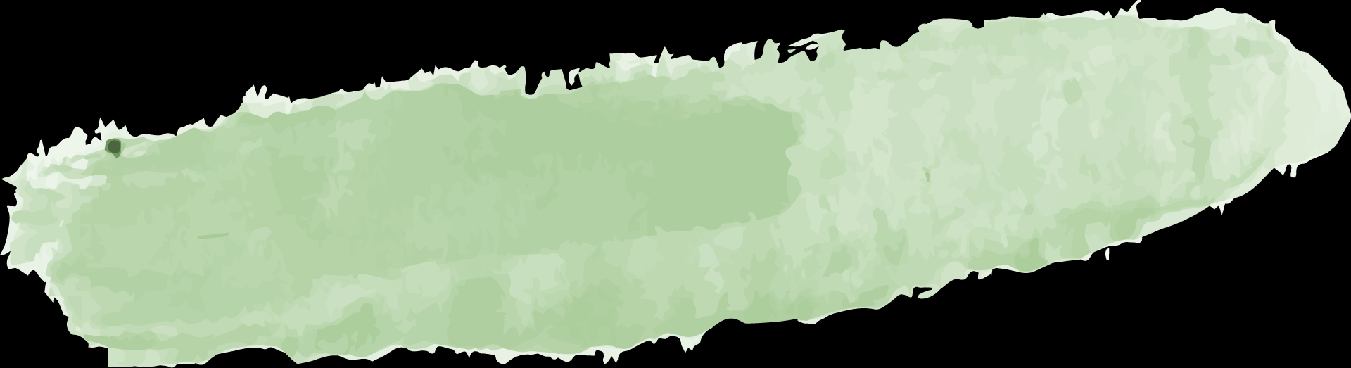


Models tried on dataset
01
Linear Regression
Not applicable because of very low correlation value.
02
K Means Clustering
Not suitable because there are no two very different clusters but overlapping ones.
03
ARIMA Model
Time series model

Slide 14
05
ARIMA Model

Slide 15
ARIMA Model
ARIMA is a form of regression analysis that indicates the strength of a dependent variable relative to other changing variables. The final objective of the model is to predict future time series movement by examining the differences between values in the series instead of through actual values. It is generally used for short term prediction of stock market.

Slide 16
06
Prediction

Slide 17
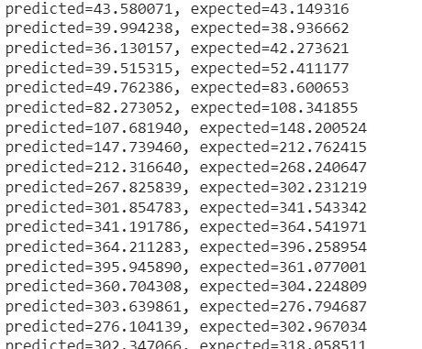
Prediction
ARIMA(1,0,0) = first-order autoregressive model: if the series is stationary and autocorrelated, perhaps it can be predicted as a multiple of its own previous value, plus a constant.

Slide 18
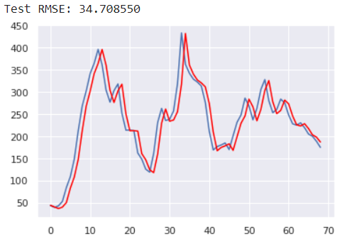

Slide 19
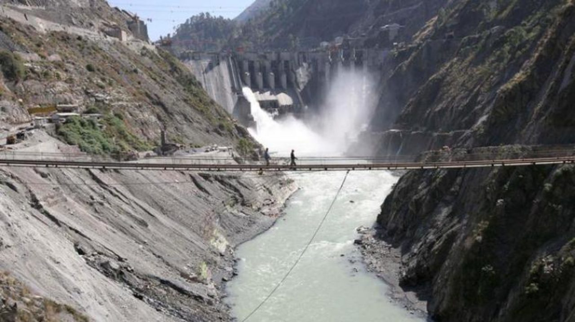

Kiru Project, Kishtwar, NHPC

Slide 20
THANKS

